Slide 1
Image Segmentation
Mustafa Madni

Slide 2
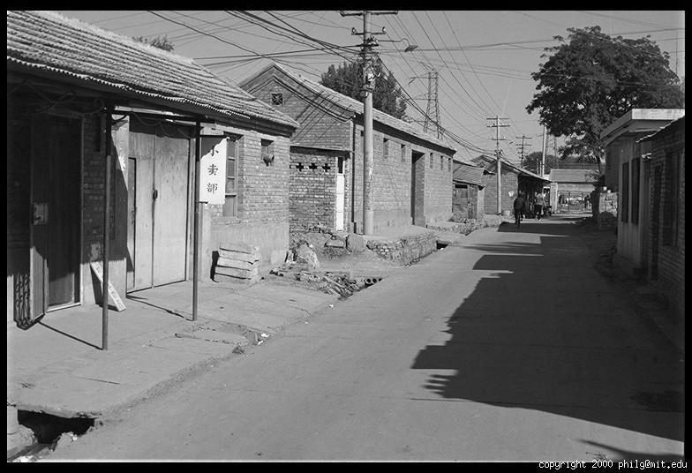
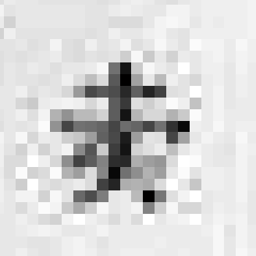
Grayscale Image
0.92 | 0.93 | 0.94 | 0.97 | 0.62 | 0.37 | 0.85 | 0.97 | 0.93 | 0.92 | 0.99
0.95 | 0.89 | 0.82 | 0.89 | 0.56 | 0.31 | 0.75 | 0.92 | 0.81 | 0.95 | 0.91
0.89 | 0.72 | 0.51 | 0.55 | 0.51 | 0.42 | 0.57 | 0.41 | 0.49 | 0.91 | 0.92
0.96 | 0.95 | 0.88 | 0.94 | 0.56 | 0.46 | 0.91 | 0.87 | 0.90 | 0.97 | 0.95
0.71 | 0.81 | 0.81 | 0.87 | 0.57 | 0.37 | 0.80 | 0.88 | 0.89 | 0.79 | 0.85
0.49 | 0.62 | 0.60 | 0.58 | 0.50 | 0.60 | 0.58 | 0.50 | 0.61 | 0.45 | 0.33
0.86 | 0.84 | 0.74 | 0.58 | 0.51 | 0.39 | 0.73 | 0.92 | 0.91 | 0.49 | 0.74
0.96 | 0.67 | 0.54 | 0.85 | 0.48 | 0.37 | 0.88 | 0.90 | 0.94 | 0.82 | 0.93
0.69 | 0.49 | 0.56 | 0.66 | 0.43 | 0.42 | 0.77 | 0.73 | 0.71 | 0.90 | 0.99
0.79 | 0.73 | 0.90 | 0.67 | 0.33 | 0.61 | 0.69 | 0.79 | 0.73 | 0.93 | 0.97
0.91 | 0.94 | 0.89 | 0.49 | 0.41 | 0.78 | 0.78 | 0.77 | 0.89 | 0.99 | 0.93

Slide 3
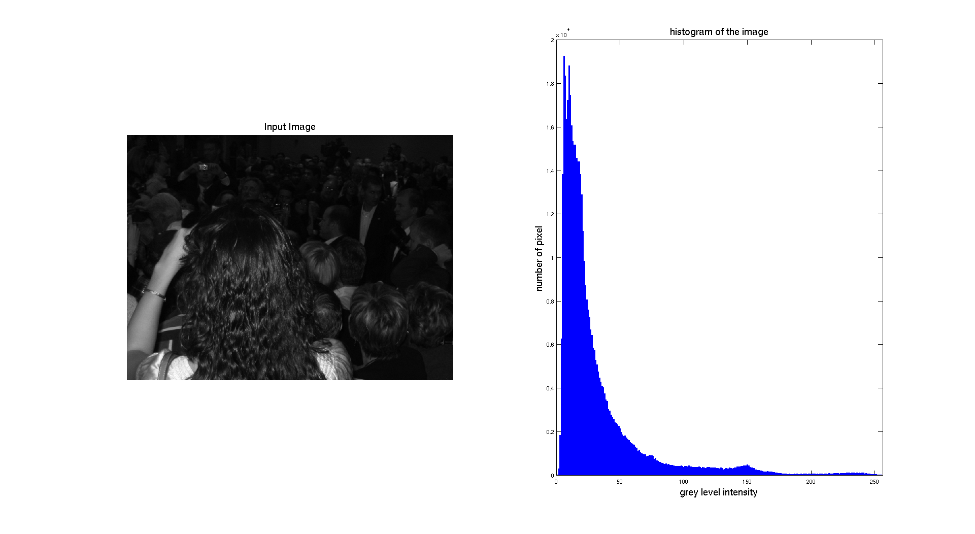
Grayscale Image Histogram

Slide 4
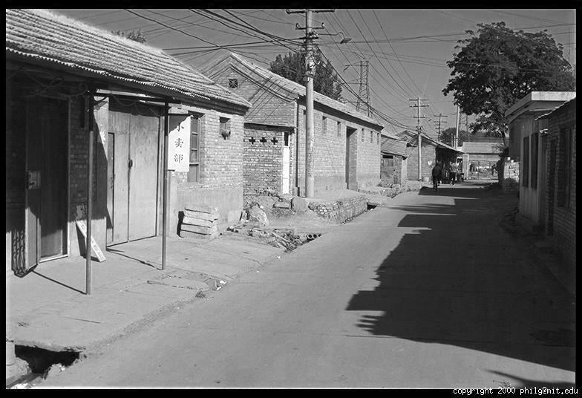
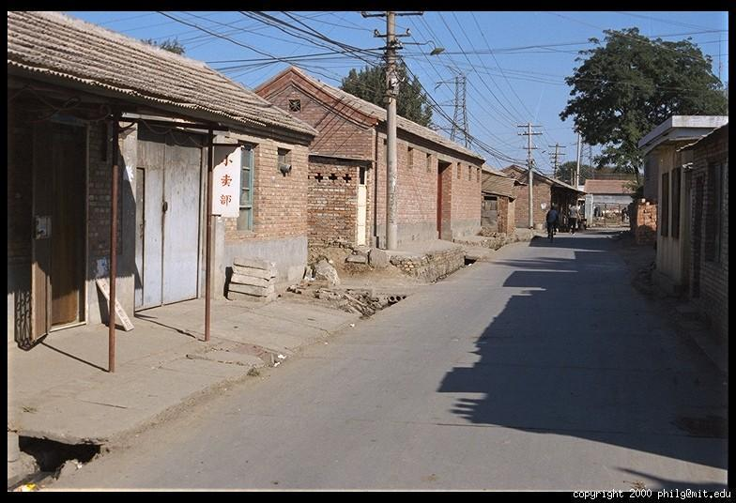
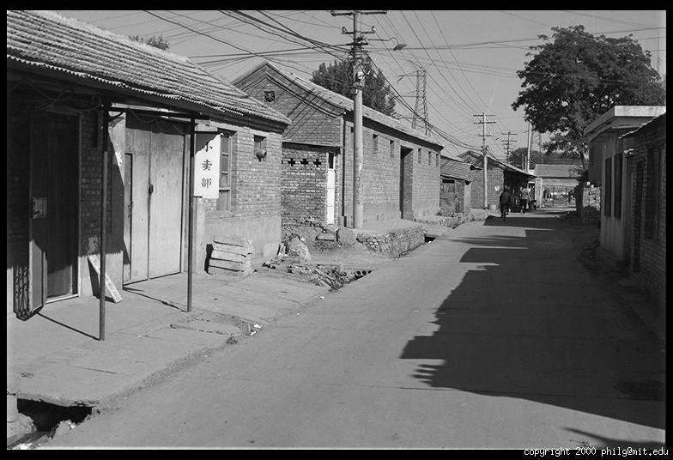
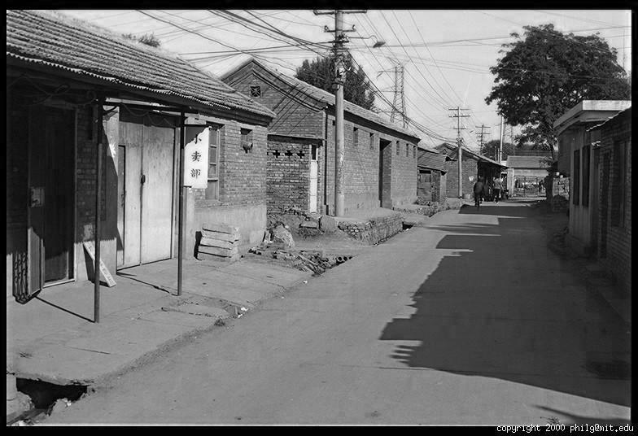
Color Image
R
G
B
James Hays

Slide 5
Color Image
Column
Row
R
0.92 | 0.93 | 0.94 | 0.97 | 0.62 | 0.37 | 0.85 | 0.97 | 0.93 | 0.92 | 0.99
0.95 | 0.89 | 0.82 | 0.89 | 0.56 | 0.31 | 0.75 | 0.92 | 0.81 | 0.95 | 0.91
0.89 | 0.72 | 0.51 | 0.55 | 0.51 | 0.42 | 0.57 | 0.41 | 0.49 | 0.91 | 0.92
0.96 | 0.95 | 0.88 | 0.94 | 0.56 | 0.46 | 0.91 | 0.87 | 0.90 | 0.97 | 0.95
0.71 | 0.81 | 0.81 | 0.87 | 0.57 | 0.37 | 0.80 | 0.88 | 0.89 | 0.79 | 0.85
0.49 | 0.62 | 0.60 | 0.58 | 0.50 | 0.60 | 0.58 | 0.50 | 0.61 | 0.45 | 0.33
0.86 | 0.84 | 0.74 | 0.58 | 0.51 | 0.39 | 0.73 | 0.92 | 0.91 | 0.49 | 0.74
0.96 | 0.67 | 0.54 | 0.85 | 0.48 | 0.37 | 0.88 | 0.90 | 0.94 | 0.82 | 0.93
0.69 | 0.49 | 0.56 | 0.66 | 0.43 | 0.42 | 0.77 | 0.73 | 0.71 | 0.90 | 0.99
0.79 | 0.73 | 0.90 | 0.67 | 0.33 | 0.61 | 0.69 | 0.79 | 0.73 | 0.93 | 0.97
0.91 | 0.94 | 0.89 | 0.49 | 0.41 | 0.78 | 0.78 | 0.77 | 0.89 | 0.99 | 0.93
G
0.92 | 0.93 | 0.94 | 0.97 | 0.62 | 0.37 | 0.85 | 0.97 | 0.93 | 0.92 | 0.99
0.95 | 0.89 | 0.82 | 0.89 | 0.56 | 0.31 | 0.75 | 0.92 | 0.81 | 0.95 | 0.91
0.89 | 0.72 | 0.51 | 0.55 | 0.51 | 0.42 | 0.57 | 0.41 | 0.49 | 0.91 | 0.92
0.96 | 0.95 | 0.88 | 0.94 | 0.56 | 0.46 | 0.91 | 0.87 | 0.90 | 0.97 | 0.95
0.71 | 0.81 | 0.81 | 0.87 | 0.57 | 0.37 | 0.80 | 0.88 | 0.89 | 0.79 | 0.85
0.49 | 0.62 | 0.60 | 0.58 | 0.50 | 0.60 | 0.58 | 0.50 | 0.61 | 0.45 | 0.33
0.86 | 0.84 | 0.74 | 0.58 | 0.51 | 0.39 | 0.73 | 0.92 | 0.91 | 0.49 | 0.74
0.96 | 0.67 | 0.54 | 0.85 | 0.48 | 0.37 | 0.88 | 0.90 | 0.94 | 0.82 | 0.93
0.69 | 0.49 | 0.56 | 0.66 | 0.43 | 0.42 | 0.77 | 0.73 | 0.71 | 0.90 | 0.99
0.79 | 0.73 | 0.90 | 0.67 | 0.33 | 0.61 | 0.69 | 0.79 | 0.73 | 0.93 | 0.97
0.91 | 0.94 | 0.89 | 0.49 | 0.41 | 0.78 | 0.78 | 0.77 | 0.89 | 0.99 | 0.93
B
0.92 | 0.93 | 0.94 | 0.97 | 0.62 | 0.37 | 0.85 | 0.97 | 0.93 | 0.92 | 0.99
0.95 | 0.89 | 0.82 | 0.89 | 0.56 | 0.31 | 0.75 | 0.92 | 0.81 | 0.95 | 0.91
0.89 | 0.72 | 0.51 | 0.55 | 0.51 | 0.42 | 0.57 | 0.41 | 0.49 | 0.91 | 0.92
0.96 | 0.95 | 0.88 | 0.94 | 0.56 | 0.46 | 0.91 | 0.87 | 0.90 | 0.97 | 0.95
0.71 | 0.81 | 0.81 | 0.87 | 0.57 | 0.37 | 0.80 | 0.88 | 0.89 | 0.79 | 0.85
0.49 | 0.62 | 0.60 | 0.58 | 0.50 | 0.60 | 0.58 | 0.50 | 0.61 | 0.45 | 0.33
0.86 | 0.84 | 0.74 | 0.58 | 0.51 | 0.39 | 0.73 | 0.92 | 0.91 | 0.49 | 0.74
0.96 | 0.67 | 0.54 | 0.85 | 0.48 | 0.37 | 0.88 | 0.90 | 0.94 | 0.82 | 0.93
0.69 | 0.49 | 0.56 | 0.66 | 0.43 | 0.42 | 0.77 | 0.73 | 0.71 | 0.90 | 0.99
0.79 | 0.73 | 0.90 | 0.67 | 0.33 | 0.61 | 0.69 | 0.79 | 0.73 | 0.93 | 0.97
0.91 | 0.94 | 0.89 | 0.49 | 0.41 | 0.78 | 0.78 | 0.77 | 0.89 | 0.99 | 0.93
James Hays

Slide 6
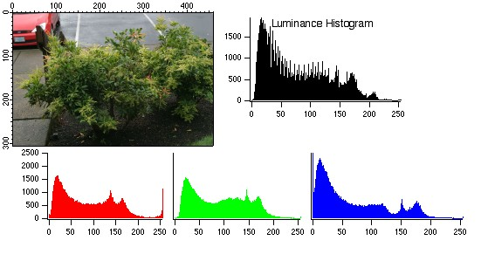
Color Image Histogram

Slide 7
Image Segmentation

Slide 8
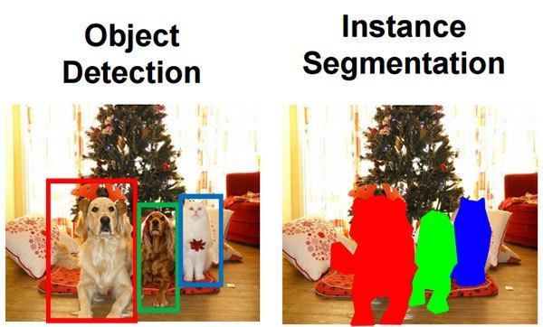
8

Slide 9
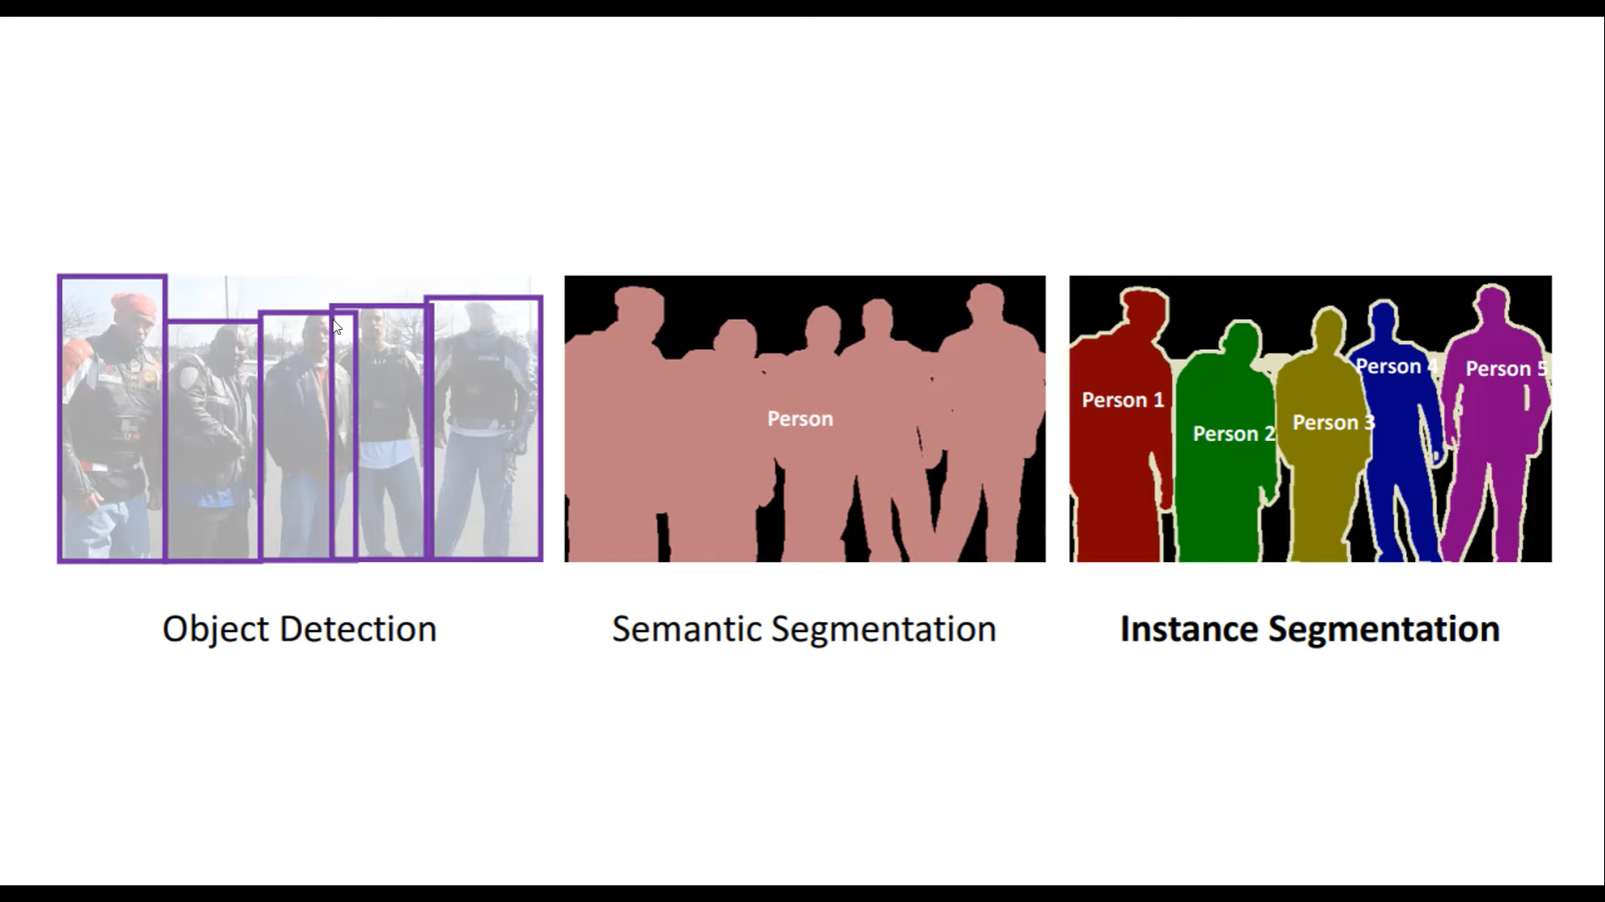

Slide 10
Image Segmentation
Group similar components (such as, pixels in an image, image frames in a video) to obtain a compact representation.
Applications: Finding tumors, veins, etc. in medical images, finding targets in satellite/aerial images, finding people in surveillance images, summarizing video, etc.
10

Slide 11
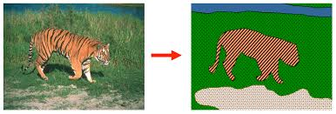
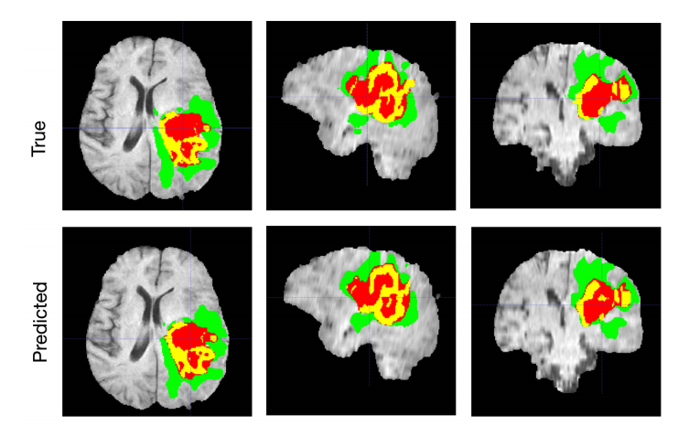
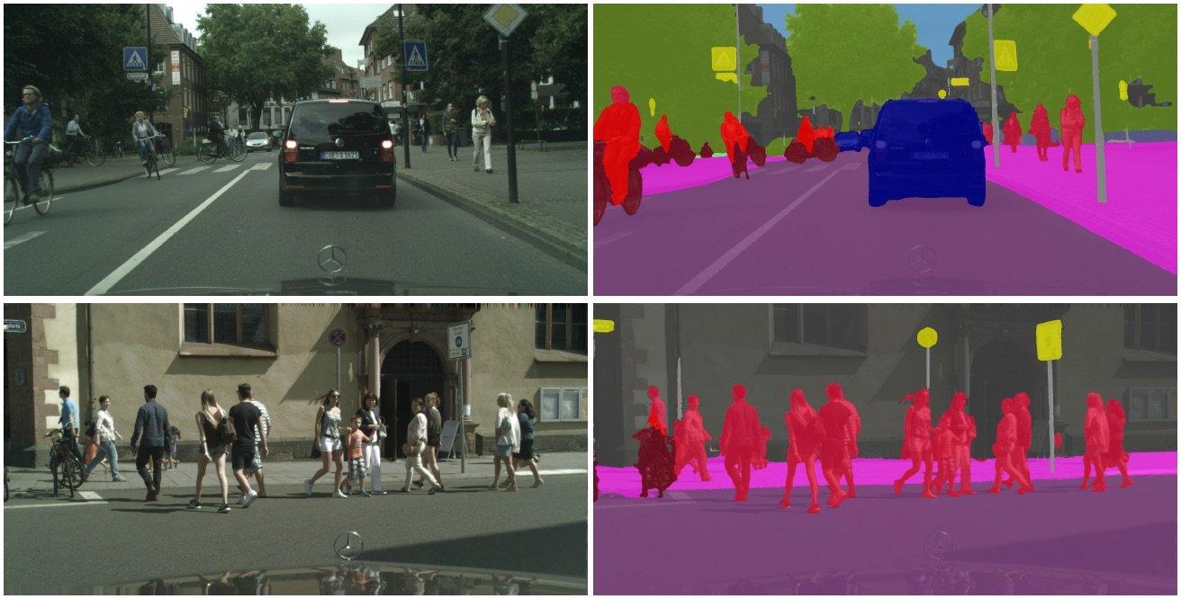
Examples

Slide 12
Image Segmentation
Segmentation algorithms for monochrome images generally are based on one of two basic properties of gray-scale values:
Discontinuity
The approach is to partition an image based on abrupt changes in gray-scale levels.
The principal areas of interest within this category are detection of isolated points, lines, and edges in an image.
Similarity
The principal approaches in this category are based on thresholding, region growing, and region splitting/merging.
12

Slide 13
Types of Image Segmentation
Traditional techniques:
Thresholding Method.
Region Based.
Merg
Split
Watershed Techniques.
K-Means Clustering.
Templates Matching.
Wavelet Based Segmentation Technique.
Contour Based Method.

Slide 14
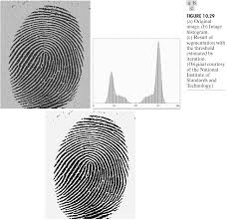
Thresholding
Suppose that an image, f(x,y), is composed of dark objects on a light background, and the following figure is the histogram of the image.
Then, the objects can be extracted by comparing pixel values with a threshold T.
14

Slide 15
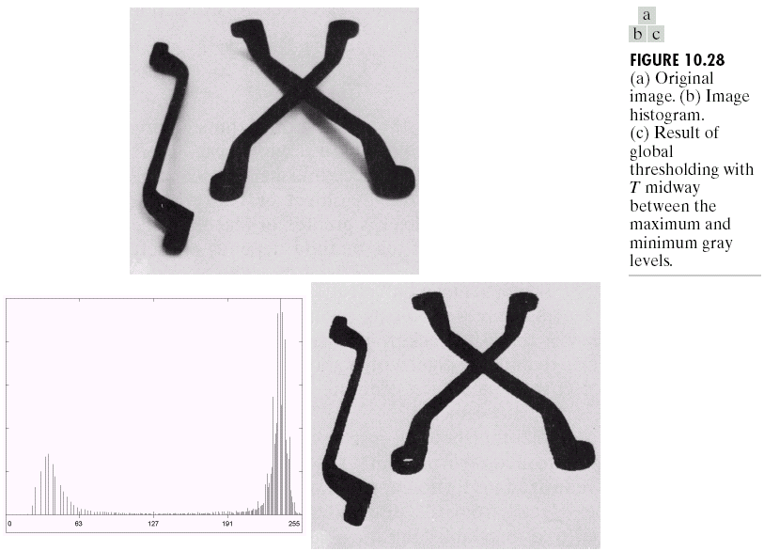
Thresholding
15

Slide 16
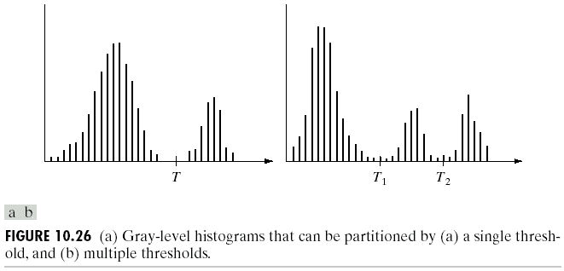
Thresholding
It is also possible to extract objects that have a specific intensity range using multiple thresholds.
Extension to color images is straightforward: There are three color channels, in each one specify the intensity range of the object… Even if objects are not separated in a single channel, they might be with all the channels… Application example: Detecting/Tracking faces based on skin color…
16

Slide 17
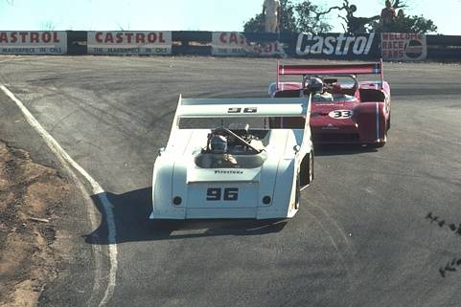
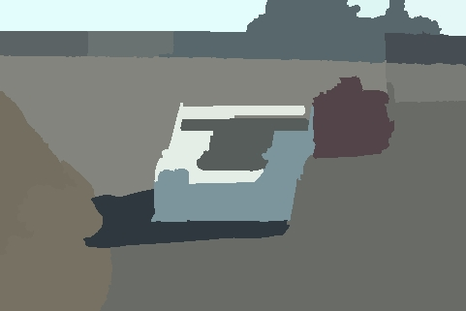
Why Region-Based Segmentation?
Segmentation
Edge detection and Thresholding not always effective.
Homogenous regions
Region-based segmentation.
Effective in noisy images.

Slide 18
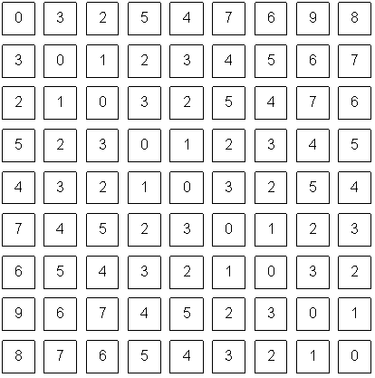
How do we form regions?
Region Growing
Region Merging
Region Splitting
Split and Merge
...
Watershed
What a computer sees

Slide 19
Region-Oriented Segmentation
Region Growing
Region growing is a procedure that groups pixels or subregions into larger regions.
The simplest of these approaches is pixel aggregation, which starts with a set of “seed” points and from these grows regions by appending to each seed points those neighboring pixels that have similar properties (such as gray level, texture, color, shape).
Region growing based techniques are better than the edge-based techniques in noisy images where edges are difficult to detect.
19

Slide 20
Region growing
Groups pixels into larger regions.
Starts with a seed region.
Grows region by merging neighboring pixels.
Iterative process
How to start?
How to iterate?
When to stop?
Finish
Initial Regions
Iterations
Stop
Condition

Slide 21
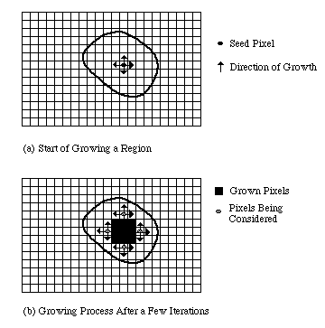
VC 14/15 - TP9 - Region-Based Segmentation

Slide 22
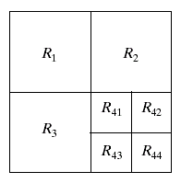
Region-Oriented Segmentation
Region Splitting
Region growing starts from a set of seed points.
An alternative is to start with the whole image as a single region and subdivide the regions that do not satisfy a condition of homogeneity.
Region Merging
Region merging is the opposite of region splitting.
Start with small regions (e.g. 2x2 or 4x4 regions) and merge the regions that have similar characteristics (such as gray level, variance).
Typically, splitting and merging approaches are used iteratively.
22

Slide 23
Region merging
Algorithm
Divide image into an initial set of regions.
One region per pixel.
Define a similarity criteria for merging regions.
Merge similar regions.
Repeat previous step until no more merge operations are possible.

Slide 24
Similarity Criteria
Homogeneity of regions is used as the main segmentation criterion in region growing.
gray level
color, texture
shape
model
etc.
Choice of criteria affects segmentation results dramatically!

Slide 25
Region splitting
Algorithm
One initial set that includes the whole image.
Similarity criteria.
Iteratively split regions into sub-regions.
Stop when no more splittings are possible.
R₁
R₁
R₂
R₃
R₄
R₁
R₂
R₁
R₂
R₃
R₃
R₄
R₅
R₄
R₅
R₆
R₇
R₆
R₇

Slide 26
Split and Merge
Combination of both algorithms.
Can handle a larger variety of shapes.
Simply apply previous algorithms consecutively.

Slide 27
Image filtering

Slide 28
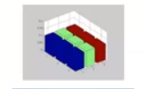

Example: box filter
1
1
1
1
1
1
1
1
1
Slide credit: David Lowe (UBC)

Slide 29
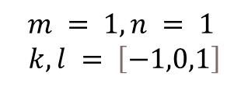
Image filtering
1
1
1
1
1
1
1
1
1
0 | 0 | 0 | 0 | 0 | 0 | 0 | 0 | 0 | 0
0 | 0 | 0 | 0 | 0 | 0 | 0 | 0 | 0 | 0
0 | 0 | 0 | 90 | 90 | 90 | 90 | 90 | 0 | 0
0 | 0 | 0 | 90 | 90 | 90 | 90 | 90 | 0 | 0
0 | 0 | 0 | 90 | 90 | 90 | 90 | 90 | 0 | 0
0 | 0 | 0 | 90 | 0 | 90 | 90 | 90 | 0 | 0
0 | 0 | 0 | 90 | 90 | 90 | 90 | 90 | 0 | 0
0 | 0 | 0 | 0 | 0 | 0 | 0 | 0 | 0 | 0
0 | 0 | 90 | 0 | 0 | 0 | 0 | 0 | 0 | 0
0 | 0 | 0 | 0 | 0 | 0 | 0 | 0 | 0 | 0
 | 0
0 | 0 | 0 | 0 | 0 | 0 | 0 | 0 | 0 | 0
0 | 0 | 0 | 0 | 0 | 0 | 0 | 0 | 0 | 0
0 | 0 | 0 | 90 | 90 | 90 | 90 | 90 | 0 | 0
0 | 0 | 0 | 90 | 90 | 90 | 90 | 90 | 0 | 0
0 | 0 | 0 | 90 | 90 | 90 | 90 | 90 | 0 | 0
0 | 0 | 0 | 90 | 0 | 90 | 90 | 90 | 0 | 0
0 | 0 | 0 | 90 | 90 | 90 | 90 | 90 | 0 | 0
0 | 0 | 0 | 0 | 0 | 0 | 0 | 0 | 0 | 0
0 | 0 | 90 | 0 | 0 | 0 | 0 | 0 | 0 | 0
0 | 0 | 0 | 0 | 0 | 0 | 0 | 0 | 0 | 0
$$m = 1, n = 1$$
$$k,l = \left[−1,0,1\right]$$
Credit: S. Seitz
Notes:
29
ones, divide by 9

Slide 30

Image filtering
1
1
1
1
1
1
1
1
1
0 | 0 | 0 | 0 | 0 | 0 | 0 | 0 | 0 | 0
0 | 0 | 0 | 0 | 0 | 0 | 0 | 0 | 0 | 0
0 | 0 | 0 | 90 | 90 | 90 | 90 | 90 | 0 | 0
0 | 0 | 0 | 90 | 90 | 90 | 90 | 90 | 0 | 0
0 | 0 | 0 | 90 | 90 | 90 | 90 | 90 | 0 | 0
0 | 0 | 0 | 90 | 0 | 90 | 90 | 90 | 0 | 0
0 | 0 | 0 | 90 | 90 | 90 | 90 | 90 | 0 | 0
0 | 0 | 0 | 0 | 0 | 0 | 0 | 0 | 0 | 0
0 | 0 | 90 | 0 | 0 | 0 | 0 | 0 | 0 | 0
0 | 0 | 0 | 0 | 0 | 0 | 0 | 0 | 0 | 0
 | 0 | 10
0 | 0 | 0 | 0 | 0 | 0 | 0 | 0 | 0 | 0
0 | 0 | 0 | 0 | 0 | 0 | 0 | 0 | 0 | 0
0 | 0 | 0 | 90 | 90 | 90 | 90 | 90 | 0 | 0
0 | 0 | 0 | 90 | 90 | 90 | 90 | 90 | 0 | 0
0 | 0 | 0 | 90 | 90 | 90 | 90 | 90 | 0 | 0
0 | 0 | 0 | 90 | 0 | 90 | 90 | 90 | 0 | 0
0 | 0 | 0 | 90 | 90 | 90 | 90 | 90 | 0 | 0
0 | 0 | 0 | 0 | 0 | 0 | 0 | 0 | 0 | 0
0 | 0 | 90 | 0 | 0 | 0 | 0 | 0 | 0 | 0
0 | 0 | 0 | 0 | 0 | 0 | 0 | 0 | 0 | 0
$$m =2, n = 1$$
$$k,l = \left[−1,0,1\right]$$
Credit: S. Seitz
Notes:
30
ones, divide by 9

Slide 31

Image filtering
1
1
1
1
1
1
1
1
1
0 | 0 | 0 | 0 | 0 | 0 | 0 | 0 | 0 | 0
0 | 0 | 0 | 0 | 0 | 0 | 0 | 0 | 0 | 0
0 | 0 | 0 | 90 | 90 | 90 | 90 | 90 | 0 | 0
0 | 0 | 0 | 90 | 90 | 90 | 90 | 90 | 0 | 0
0 | 0 | 0 | 90 | 90 | 90 | 90 | 90 | 0 | 0
0 | 0 | 0 | 90 | 0 | 90 | 90 | 90 | 0 | 0
0 | 0 | 0 | 90 | 90 | 90 | 90 | 90 | 0 | 0
0 | 0 | 0 | 0 | 0 | 0 | 0 | 0 | 0 | 0
0 | 0 | 90 | 0 | 0 | 0 | 0 | 0 | 0 | 0
0 | 0 | 0 | 0 | 0 | 0 | 0 | 0 | 0 | 0
 | 0 | 10 | 20
0 | 0 | 0 | 0 | 0 | 0 | 0 | 0 | 0 | 0
0 | 0 | 0 | 0 | 0 | 0 | 0 | 0 | 0 | 0
0 | 0 | 0 | 90 | 90 | 90 | 90 | 90 | 0 | 0
0 | 0 | 0 | 90 | 90 | 90 | 90 | 90 | 0 | 0
0 | 0 | 0 | 90 | 90 | 90 | 90 | 90 | 0 | 0
0 | 0 | 0 | 90 | 0 | 90 | 90 | 90 | 0 | 0
0 | 0 | 0 | 90 | 90 | 90 | 90 | 90 | 0 | 0
0 | 0 | 0 | 0 | 0 | 0 | 0 | 0 | 0 | 0
0 | 0 | 90 | 0 | 0 | 0 | 0 | 0 | 0 | 0
0 | 0 | 0 | 0 | 0 | 0 | 0 | 0 | 0 | 0
$$m =3, n = 1$$
$$k,l = \left[−1,0,1\right]$$
Credit: S. Seitz
Notes:
31
ones, divide by 9

Slide 32

Image filtering
1
1
1
1
1
1
1
1
1
0 | 0 | 0 | 0 | 0 | 0 | 0 | 0 | 0 | 0
0 | 0 | 0 | 0 | 0 | 0 | 0 | 0 | 0 | 0
0 | 0 | 0 | 90 | 90 | 90 | 90 | 90 | 0 | 0
0 | 0 | 0 | 90 | 90 | 90 | 90 | 90 | 0 | 0
0 | 0 | 0 | 90 | 90 | 90 | 90 | 90 | 0 | 0
0 | 0 | 0 | 90 | 0 | 90 | 90 | 90 | 0 | 0
0 | 0 | 0 | 90 | 90 | 90 | 90 | 90 | 0 | 0
0 | 0 | 0 | 0 | 0 | 0 | 0 | 0 | 0 | 0
0 | 0 | 90 | 0 | 0 | 0 | 0 | 0 | 0 | 0
0 | 0 | 0 | 0 | 0 | 0 | 0 | 0 | 0 | 0
 | 0 | 10 | 20 | 30
0 | 0 | 0 | 0 | 0 | 0 | 0 | 0 | 0 | 0
0 | 0 | 0 | 0 | 0 | 0 | 0 | 0 | 0 | 0
0 | 0 | 0 | 90 | 90 | 90 | 90 | 90 | 0 | 0
0 | 0 | 0 | 90 | 90 | 90 | 90 | 90 | 0 | 0
0 | 0 | 0 | 90 | 90 | 90 | 90 | 90 | 0 | 0
0 | 0 | 0 | 90 | 0 | 90 | 90 | 90 | 0 | 0
0 | 0 | 0 | 90 | 90 | 90 | 90 | 90 | 0 | 0
0 | 0 | 0 | 0 | 0 | 0 | 0 | 0 | 0 | 0
0 | 0 | 90 | 0 | 0 | 0 | 0 | 0 | 0 | 0
0 | 0 | 0 | 0 | 0 | 0 | 0 | 0 | 0 | 0
$$m =4, n = 1$$
$$k,l = \left[−1,0,1\right]$$
Credit: S. Seitz
Notes:
32
ones, divide by 9

Slide 33

Image filtering
1
1
1
1
1
1
1
1
1
0 | 0 | 0 | 0 | 0 | 0 | 0 | 0 | 0 | 0
0 | 0 | 0 | 0 | 0 | 0 | 0 | 0 | 0 | 0
0 | 0 | 0 | 90 | 90 | 90 | 90 | 90 | 0 | 0
0 | 0 | 0 | 90 | 90 | 90 | 90 | 90 | 0 | 0
0 | 0 | 0 | 90 | 90 | 90 | 90 | 90 | 0 | 0
0 | 0 | 0 | 90 | 0 | 90 | 90 | 90 | 0 | 0
0 | 0 | 0 | 90 | 90 | 90 | 90 | 90 | 0 | 0
0 | 0 | 0 | 0 | 0 | 0 | 0 | 0 | 0 | 0
0 | 0 | 90 | 0 | 0 | 0 | 0 | 0 | 0 | 0
0 | 0 | 0 | 0 | 0 | 0 | 0 | 0 | 0 | 0
 | 0 | 10 | 20 | 30 | 30
$$m =5, n = 1$$
$$k,l = \left[−1,0,1\right]$$
Credit: S. Seitz
Notes:
33
ones, divide by 9

Slide 34

Image filtering
1
1
1
1
1
1
1
1
1
0 | 0 | 0 | 0 | 0 | 0 | 0 | 0 | 0 | 0
0 | 0 | 0 | 0 | 0 | 0 | 0 | 0 | 0 | 0
0 | 0 | 0 | 90 | 90 | 90 | 90 | 90 | 0 | 0
0 | 0 | 0 | 90 | 90 | 90 | 90 | 90 | 0 | 0
0 | 0 | 0 | 90 | 90 | 90 | 90 | 90 | 0 | 0
0 | 0 | 0 | 90 | 0 | 90 | 90 | 90 | 0 | 0
0 | 0 | 0 | 90 | 90 | 90 | 90 | 90 | 0 | 0
0 | 0 | 0 | 0 | 0 | 0 | 0 | 0 | 0 | 0
0 | 0 | 90 | 0 | 0 | 0 | 0 | 0 | 0 | 0
0 | 0 | 0 | 0 | 0 | 0 | 0 | 0 | 0 | 0
 | 0 | 10 | 20 | 30 | 30
?
$$m =4, n =6$$
$$k,l = \left[−1,0,1\right]$$
Credit: S. Seitz
Notes:
34
ones, divide by 9

Slide 35
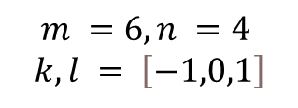
Image filtering
1
1
1
1
1
1
1
1
1
0 | 0 | 0 | 0 | 0 | 0 | 0 | 0 | 0 | 0
0 | 0 | 0 | 0 | 0 | 0 | 0 | 0 | 0 | 0
0 | 0 | 0 | 90 | 90 | 90 | 90 | 90 | 0 | 0
0 | 0 | 0 | 90 | 90 | 90 | 90 | 90 | 0 | 0
0 | 0 | 0 | 90 | 90 | 90 | 90 | 90 | 0 | 0
0 | 0 | 0 | 90 | 0 | 90 | 90 | 90 | 0 | 0
0 | 0 | 0 | 90 | 90 | 90 | 90 | 90 | 0 | 0
0 | 0 | 0 | 0 | 0 | 0 | 0 | 0 | 0 | 0
0 | 0 | 90 | 0 | 0 | 0 | 0 | 0 | 0 | 0
0 | 0 | 0 | 0 | 0 | 0 | 0 | 0 | 0 | 0
 | 0 | 10 | 20 | 30 | 30
 |  |  |  | 50
?
$$m =6, n =4$$
$$k,l = \left[−1,0,1\right]$$
Credit: S. Seitz
Notes:
35
ones, divide by 9

Slide 36
Image filtering
1
1
1
1
1
1
1
1
1
0 | 0 | 0 | 0 | 0 | 0 | 0 | 0 | 0 | 0
0 | 0 | 0 | 0 | 0 | 0 | 0 | 0 | 0 | 0
0 | 0 | 0 | 90 | 90 | 90 | 90 | 90 | 0 | 0
0 | 0 | 0 | 90 | 90 | 90 | 90 | 90 | 0 | 0
0 | 0 | 0 | 90 | 90 | 90 | 90 | 90 | 0 | 0
0 | 0 | 0 | 90 | 0 | 90 | 90 | 90 | 0 | 0
0 | 0 | 0 | 90 | 90 | 90 | 90 | 90 | 0 | 0
0 | 0 | 0 | 0 | 0 | 0 | 0 | 0 | 0 | 0
0 | 0 | 90 | 0 | 0 | 0 | 0 | 0 | 0 | 0
0 | 0 | 0 | 0 | 0 | 0 | 0 | 0 | 0 | 0
 | 0 | 10 | 20 | 30 | 30 | 30 | 20 | 10
 | 0 | 20 | 40 | 60 | 60 | 60 | 40 | 20
 | 0 | 30 | 60 | 90 | 90 | 90 | 60 | 30
 | 0 | 30 | 50 | 80 | 80 | 90 | 60 | 30
 | 0 | 30 | 50 | 80 | 80 | 90 | 60 | 30
 | 0 | 20 | 30 | 50 | 50 | 60 | 40 | 20
 | 10 | 20 | 30 | 30 | 30 | 30 | 20 | 10
 | 10 | 10 | 10 | 0 | 0 | 0 | 0 | 0
Credit: S. Seitz
Notes:
36

Slide 37
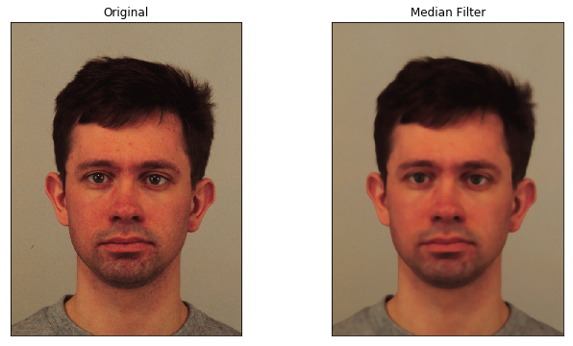
Image filtering

Slide 38
A quick Reminder

Slide 39
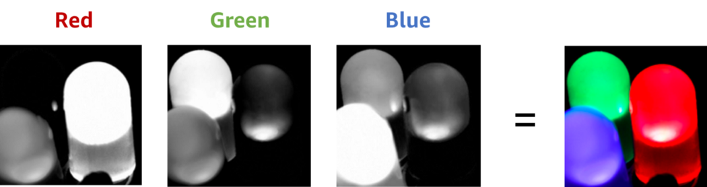
Color Image

Slide 40
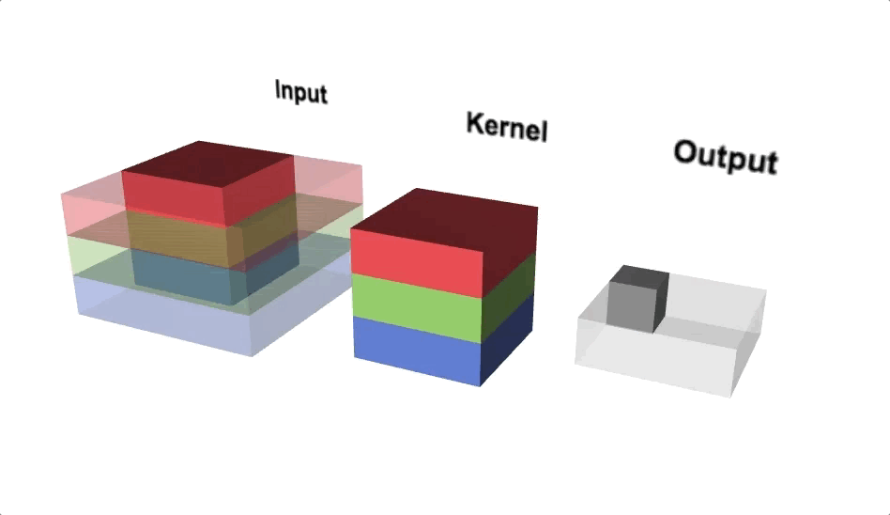
Convolution

Slide 41
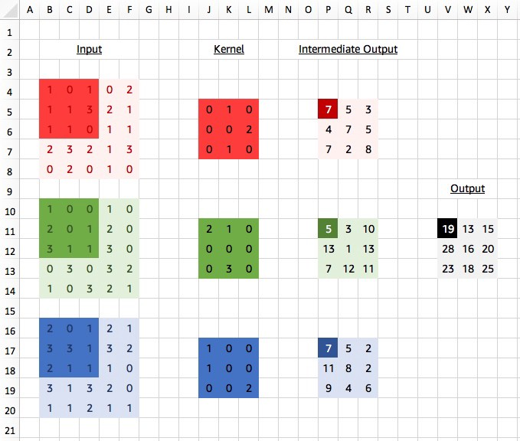
Convolution

Slide 42
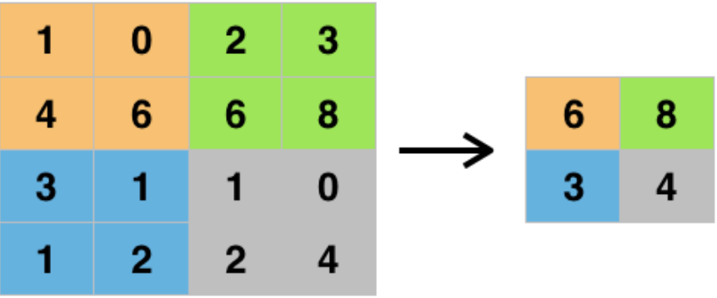
Max Pooling
2 x 2 max pooling

Slide 43
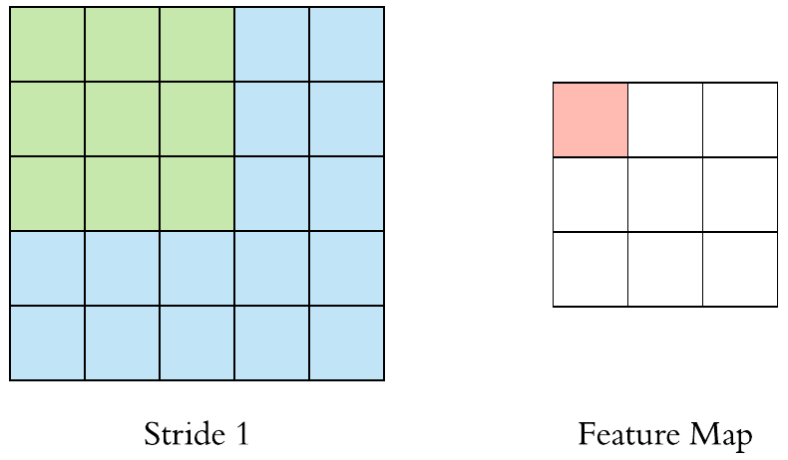
Stride

Slide 44
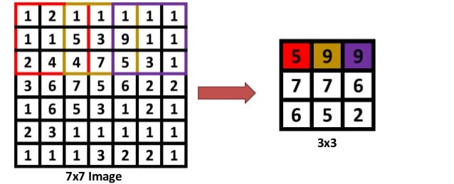
Stride = 2
Max Pooling 3 x 3, stride=2

Slide 45
Stride = 2
Max Pooling 3 x 3, stride=2

Slide 46
Stride = 2
Max Pooling 3 x 3, stride=2

Slide 47
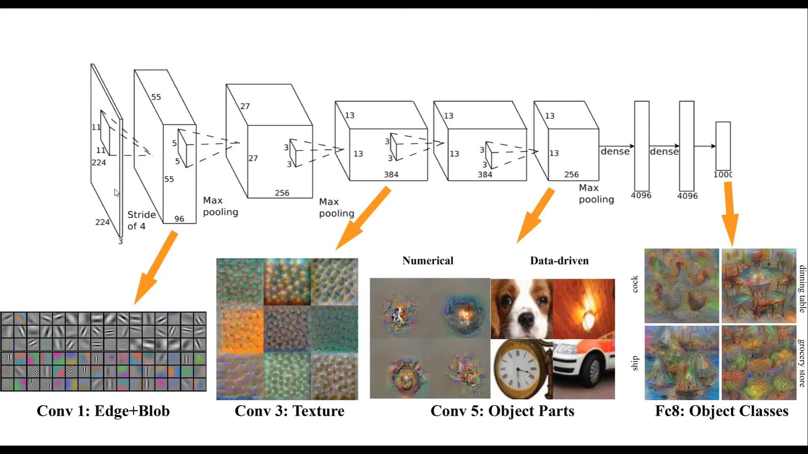

Slide 48
Semantic Segmentation

Slide 49
The Task
person
grass
trees
motorbike
road

Slide 50
Things vs Stuff
THINGS
Person, cat, horse, etc
Constrained shape
Individual instances with separate identity
May need to look at objects
STUFF
Road, grass, sky etc
Amorphous, no shape
No notion of instances
Can be done at pixel level
“texture”

Slide 51
Challenges in data collection
Precise localization is hard to annotate
Annotating every pixel leads to heavy tails
Common solution: annotate few classes (often things), mark rest as “Other”
Common datasets: PASCAL VOC 2012 (~1500 images, 20 categories), COCO (~100k images, 20 categories)

Slide 52
Pre-convnet semantic segmentation
Things
Do object detection, then segment out detected objects
Stuff
”Texture classification”
Compute histograms of filter responses
Classify local image patches

Slide 53
Semantic segmentation using convolutional networks
w
3
h

Slide 54
Semantic segmentation using convolutional networks
c
w/4
h/4

Slide 55
Semantic segmentation using convolutional networks
c
w/4
h/4

Slide 56
Semantic segmentation using convolutional networks
c
w/4
Can be considered as a feature vector for a pixel
h/4

Slide 57
Semantic segmentation using convolutional networks
c
#classes
Convolve with #classes 1x1 filters
w/4
h/4

Slide 58
Semantic segmentation using convolutional networks
Pass image through convolution and subsampling layers
Final convolution with #classes outputs
Get scores for subsampled image
Upsample back to original size

Slide 59
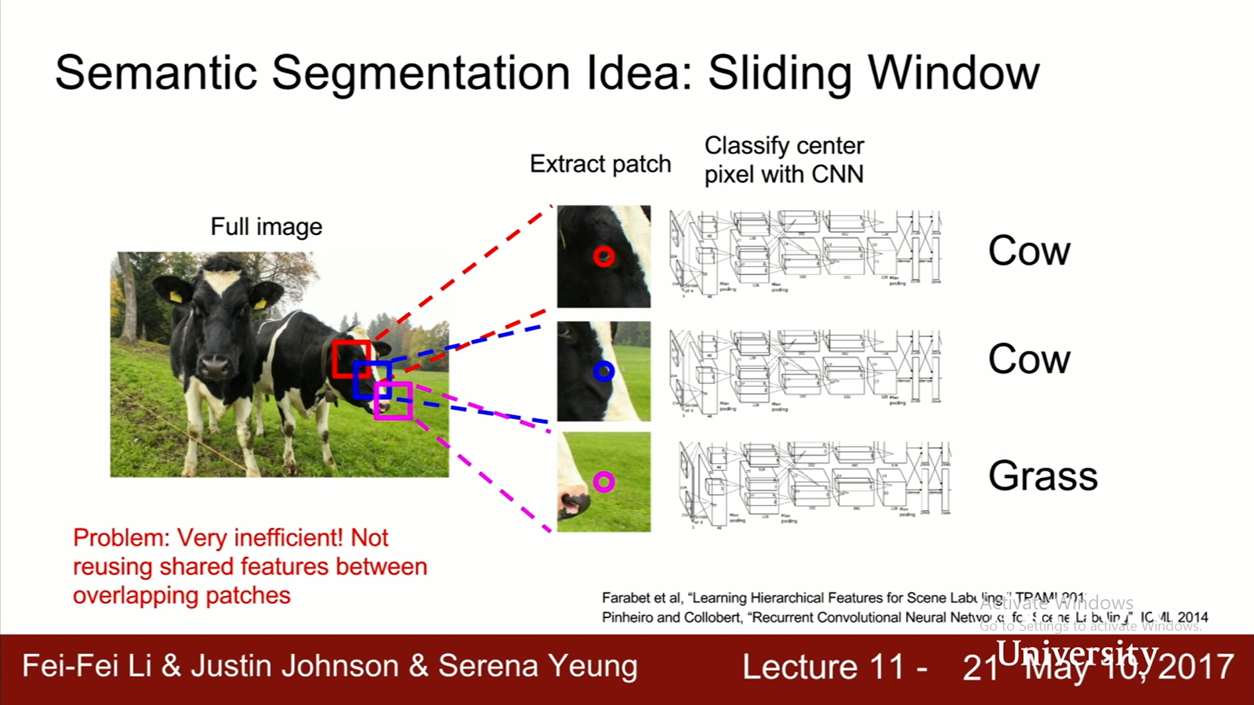

Slide 60
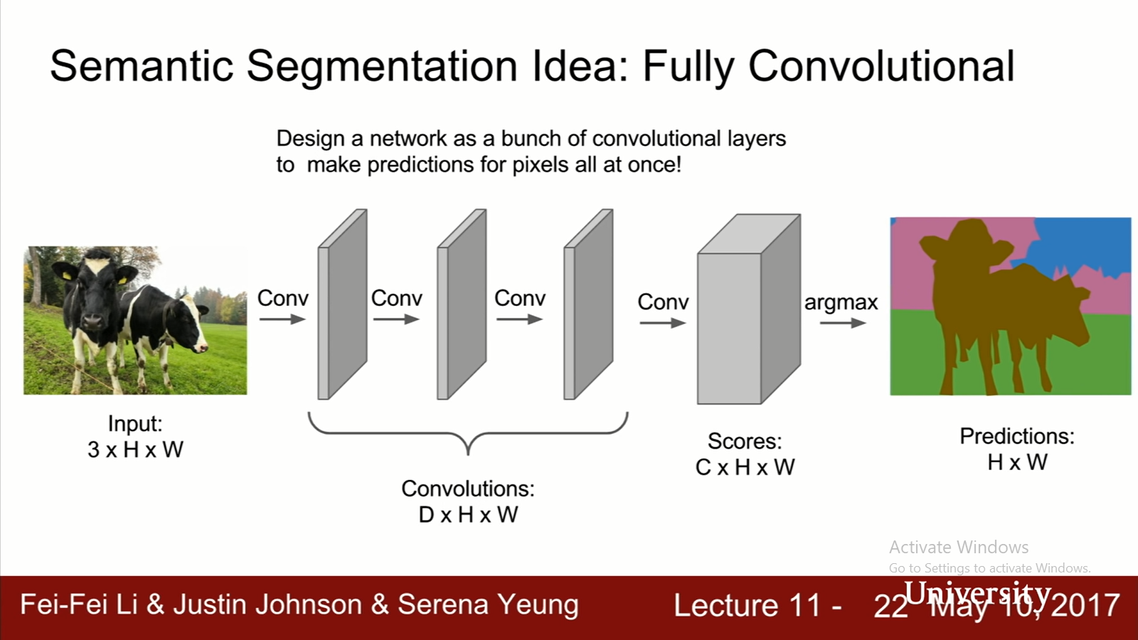

Slide 61
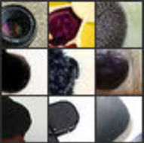
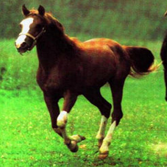
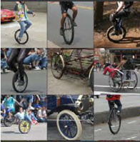
Semantic segmentation using convolutional networks
Problem: early layers not semantic
Horse
Visualizations from : M. Zeiler and R. Fergus. Visualizing and Understanding Convolutional Networks. In ECCV 2014.
Notes:
If you look at what one of these higher layers is detecting, here I am showing the input image patches that are highly scored by one of the units. This particular layer really likes bicycle wheels, so if this unit fires, you know that there is a bicycle wheel in the image. Unfortunately, you don’t know where the bicycle wheel is, because this unit doesn’t care where the bicycle wheel appears, or at what orientation or what scale.
61

Slide 62
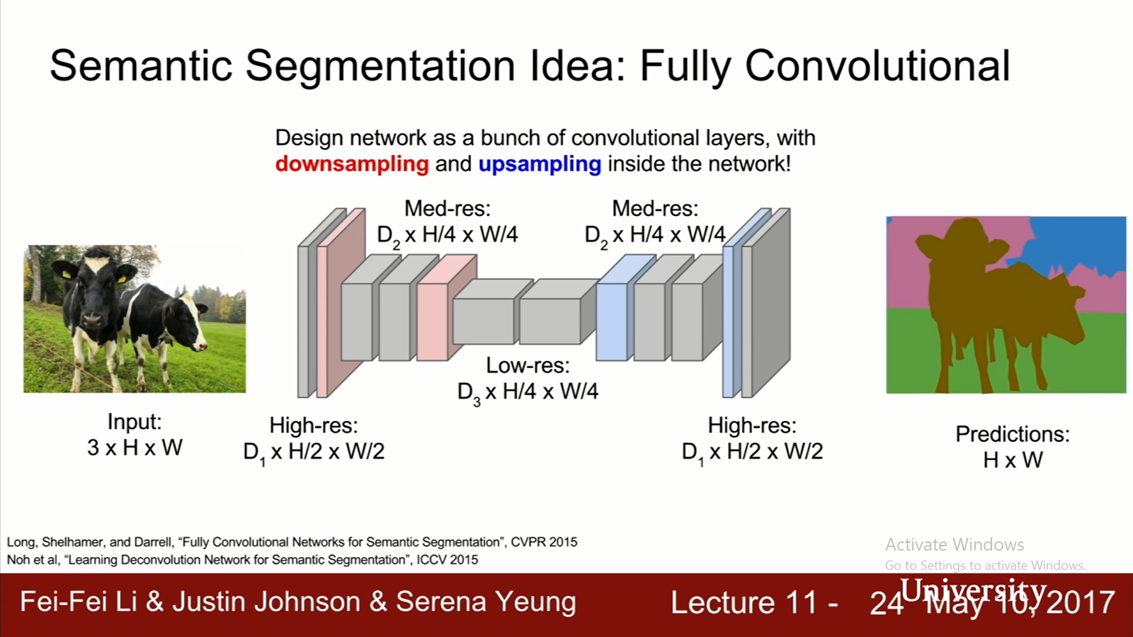

Slide 63
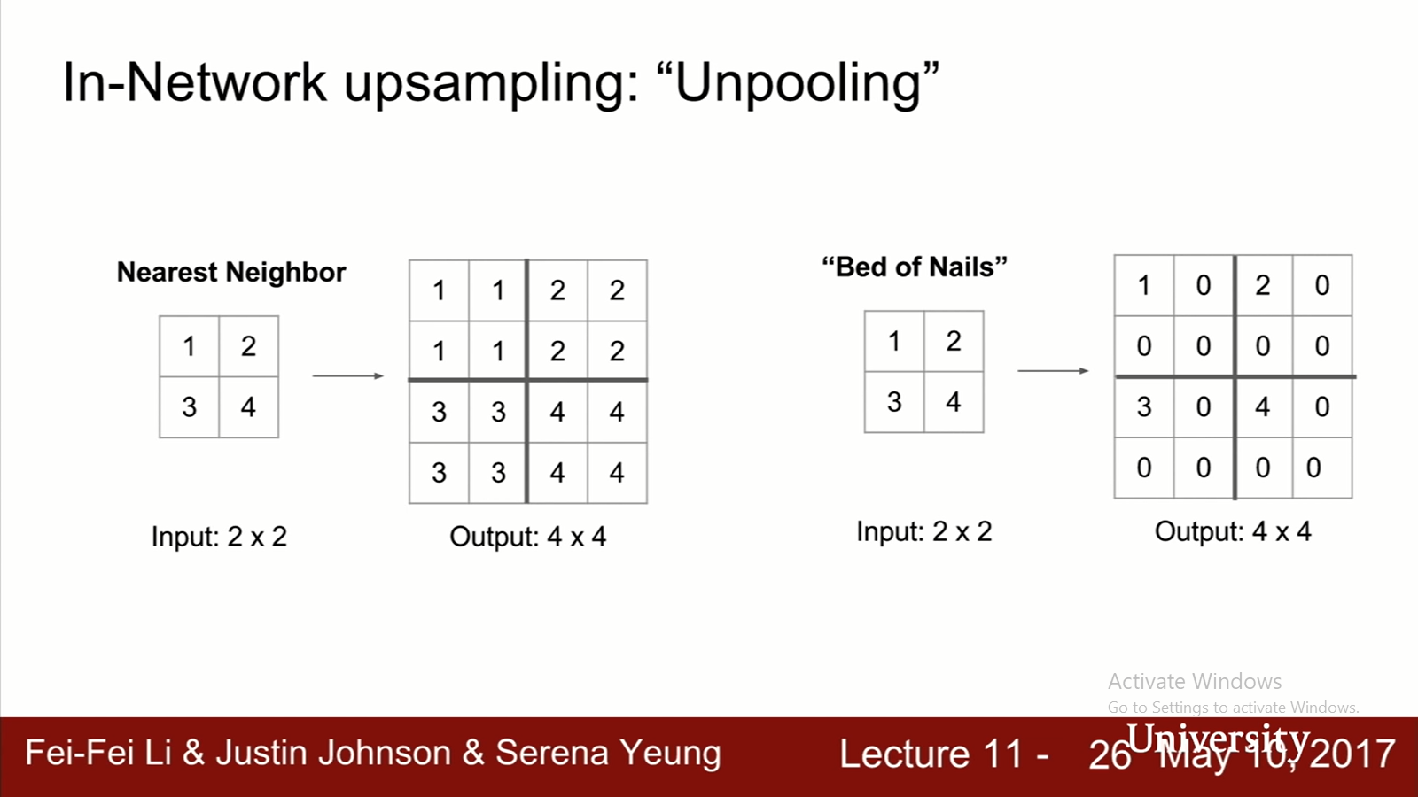

Slide 64
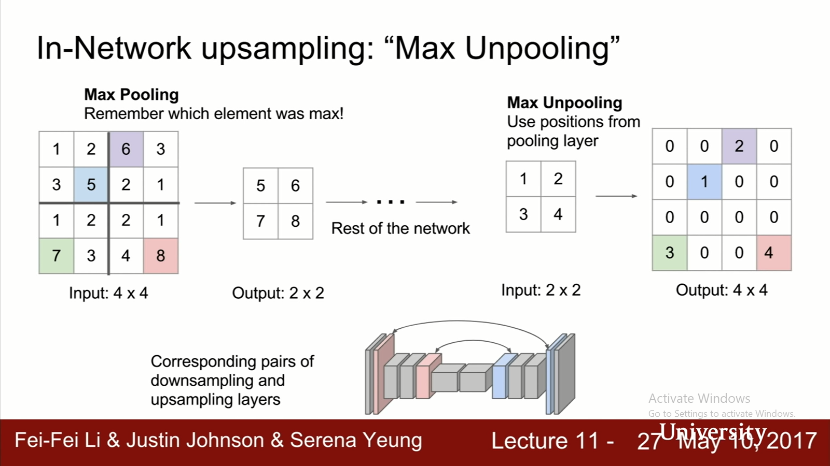

Slide 65
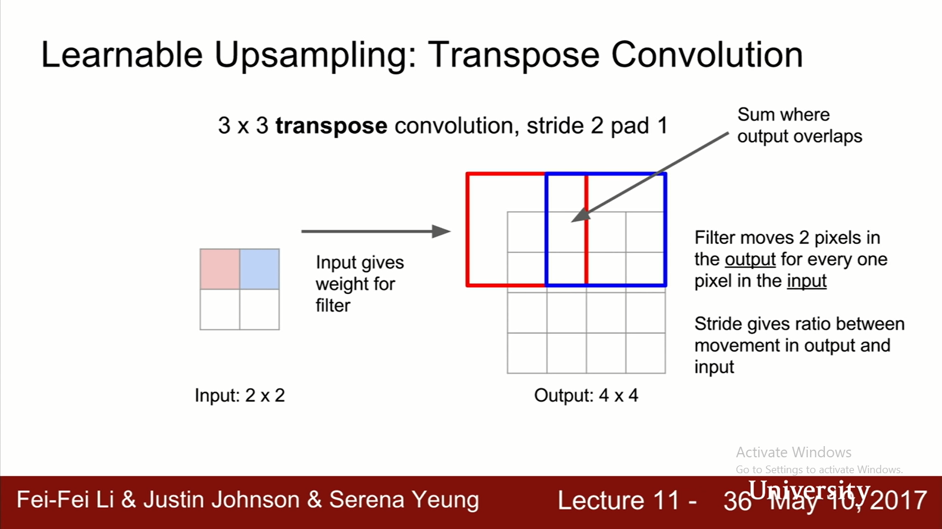

Slide 66
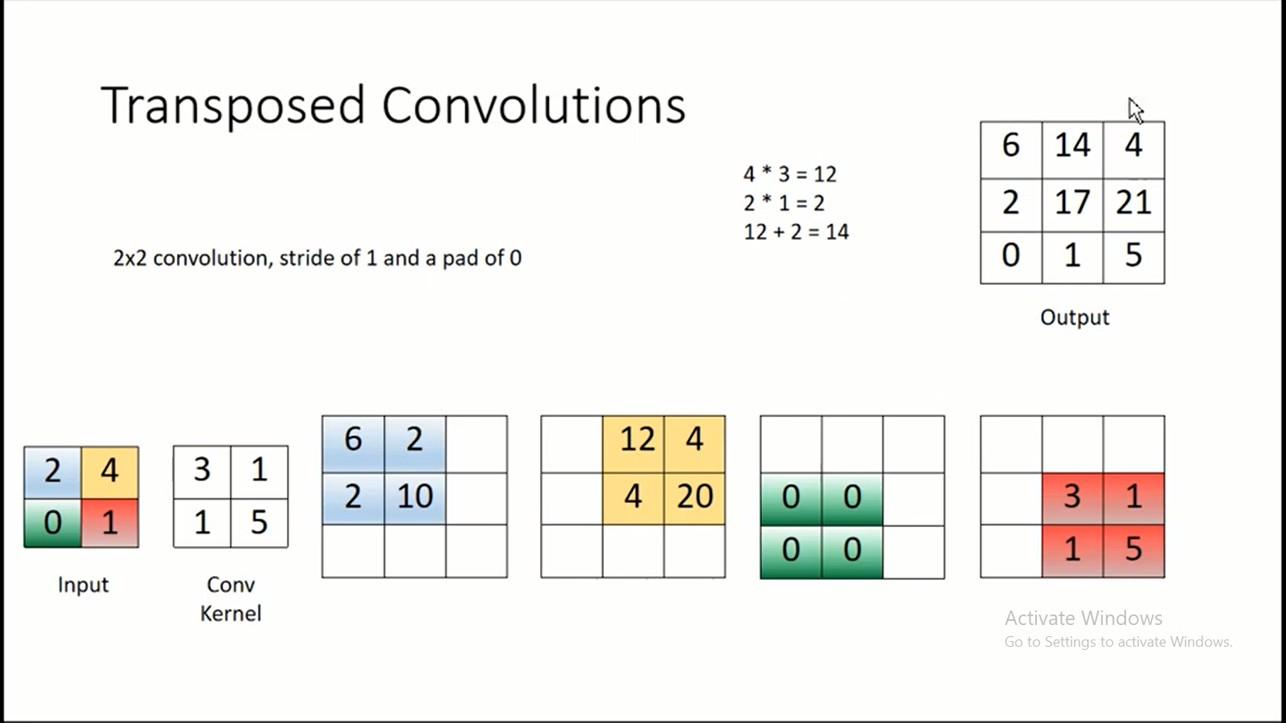

Slide 67
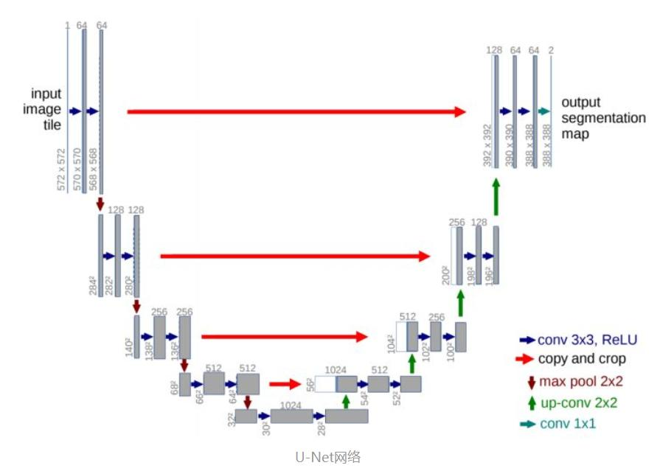
U-Net

Slide 68
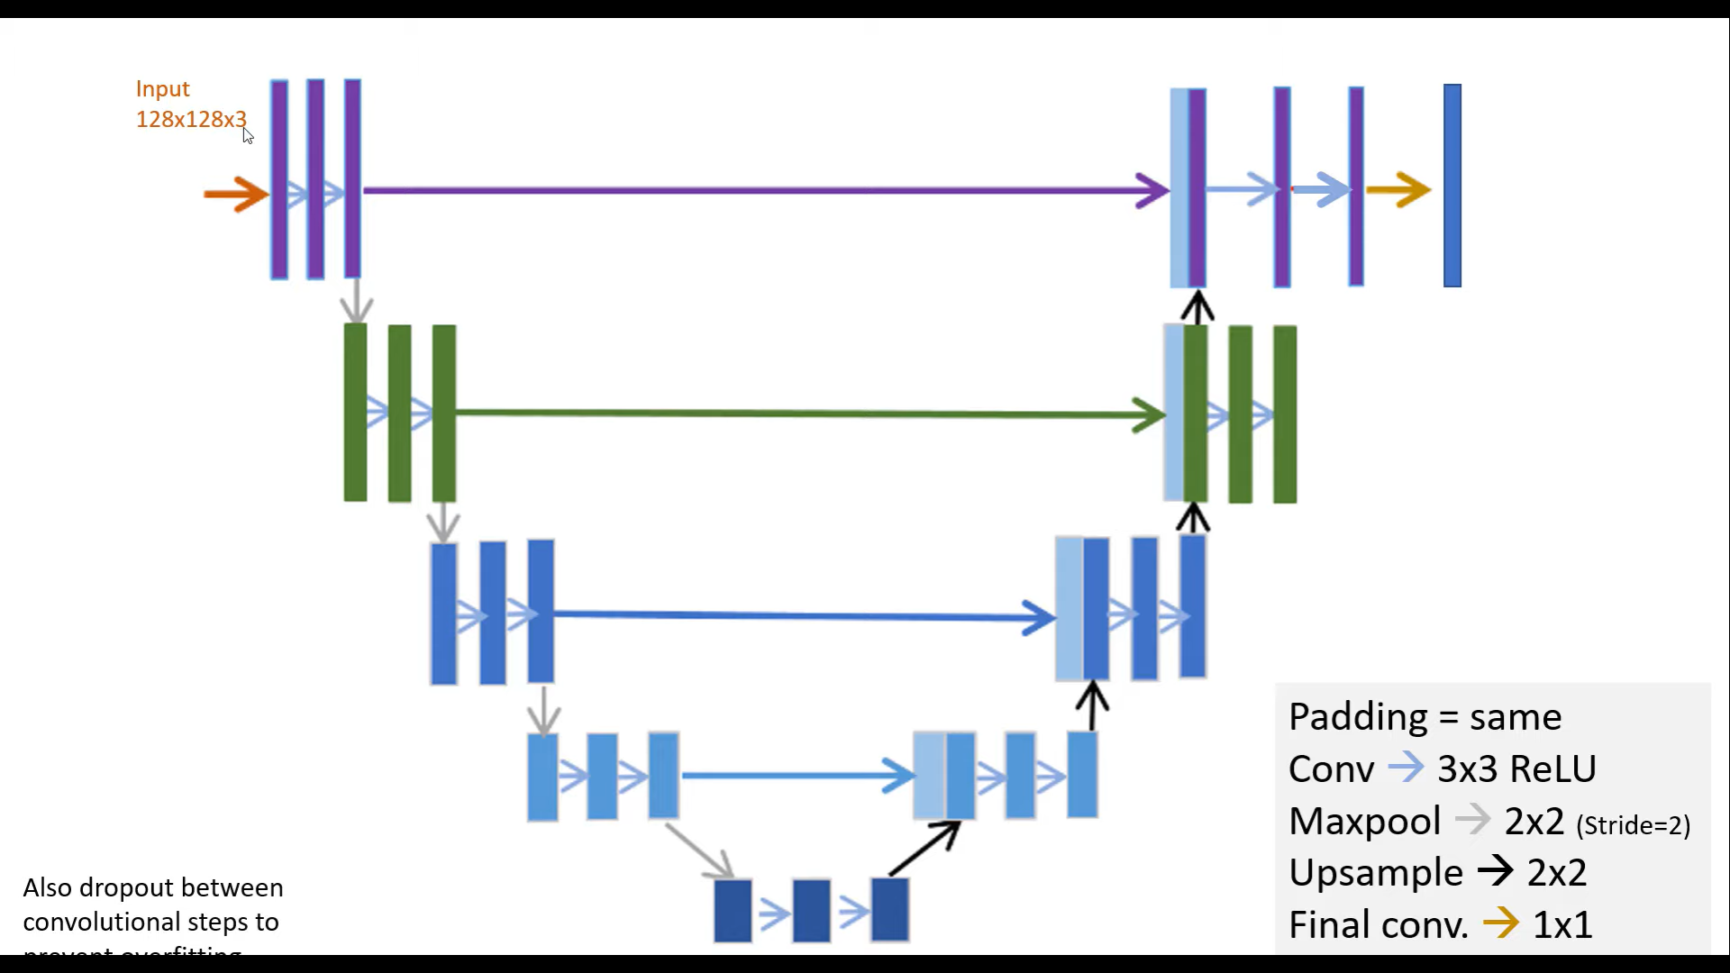

Slide 69
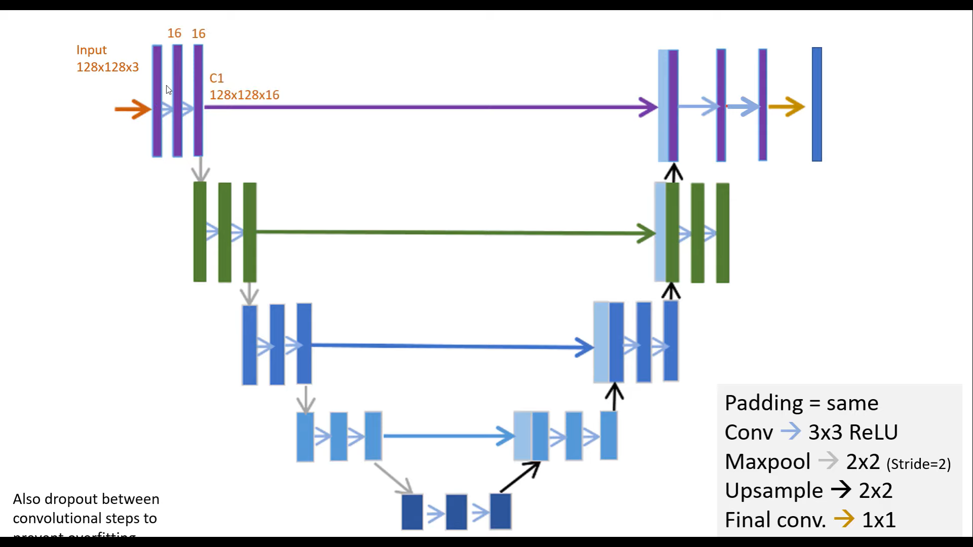

Slide 70
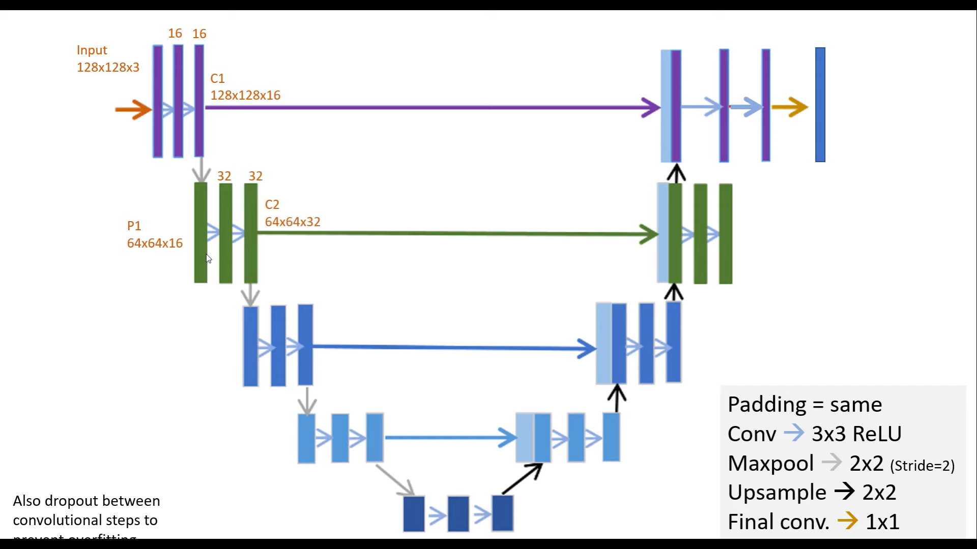

Slide 71


Slide 72
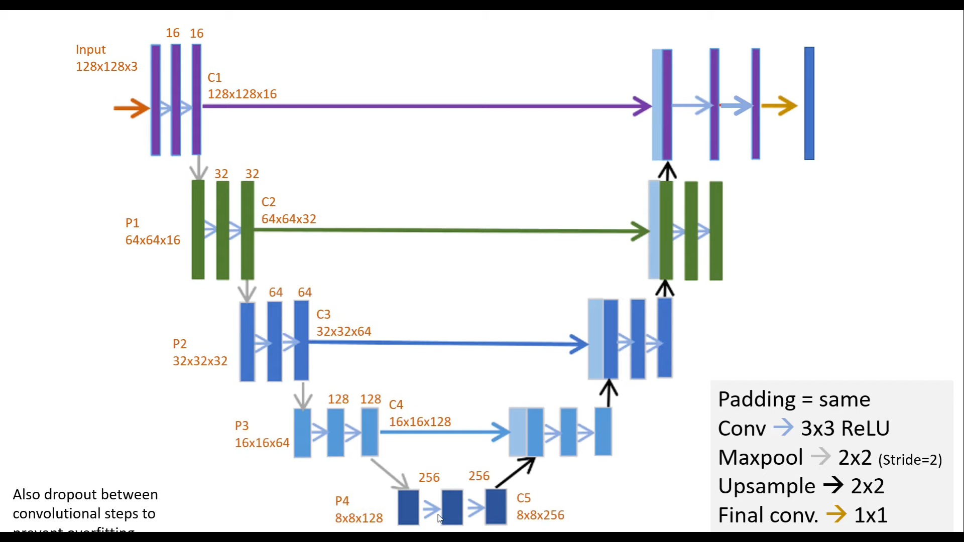

Slide 73
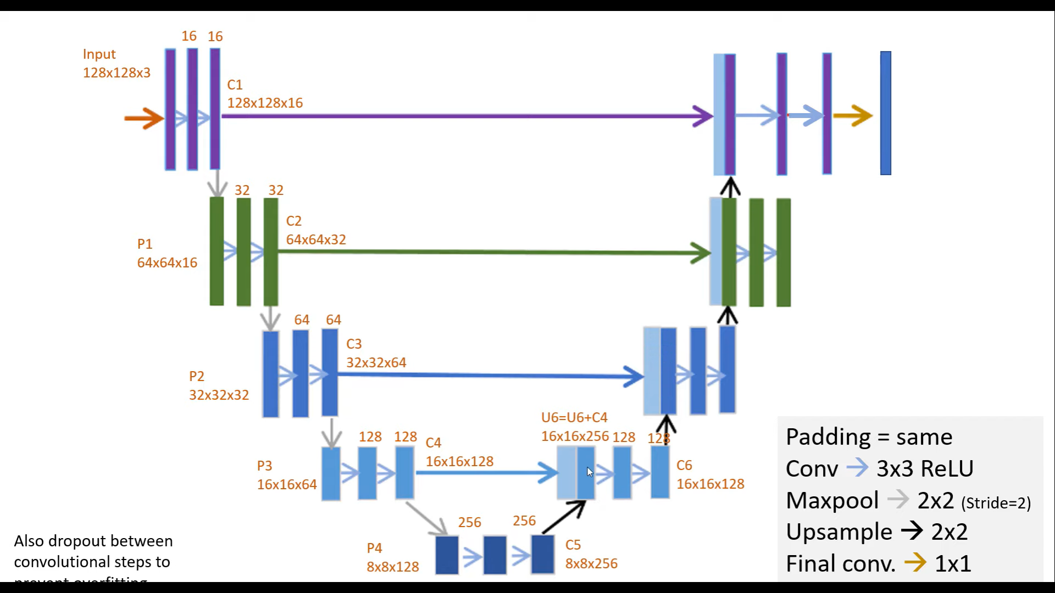

Slide 74
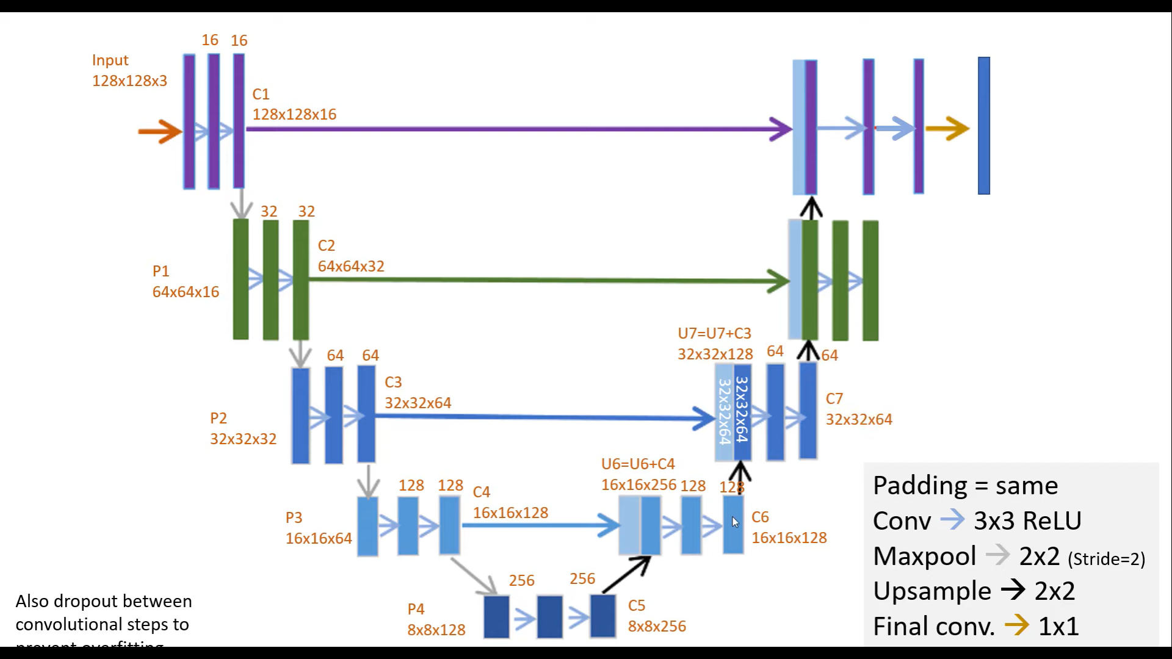

Slide 75
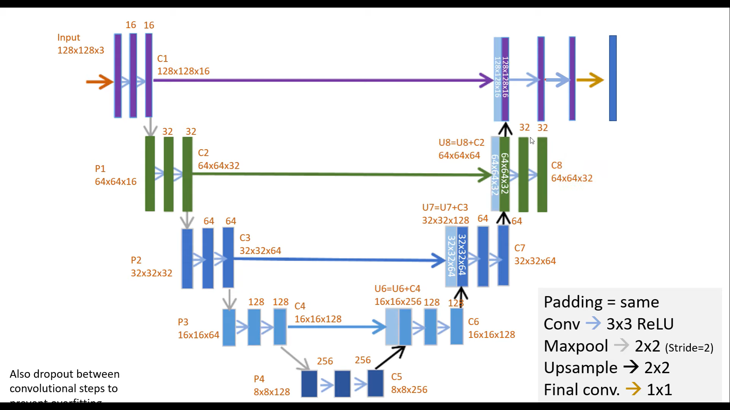

Slide 76


Slide 77


Slide 78


Semantic segmentation using convolutional networks
person
bicycle

Slide 79

Skip connections
without skip
with skip
Fully convolutional networks for semantic segmentation. Evan Shelhamer, Jon Long, Trevor Darrell. In CVPR 2015

Slide 80
Applications in Medical Imaging
Brain segmentation
Infant brain segmentation
Hippocampus Segmentation
Disease diagnosis and Prognosis
Brain tumor
Breast cancer
Lung diseases

Slide 81
Q&A

Slide 82


Quiz 04
Q1) Formulate the basic idea to analyze the optical flow for the motion analysis of two given consective video frames. (4)
Q2) How we can formulate the constraint equation using two assuptions. (3)
Q3) How we can avoid the aperture problem to compute optical flow (u, v) (3)

Slide 83



Slide 84


Slide 85


Slide 86


Slide 87


